Slide 1

Motivation:
- LinkedIn/corporate headshots require specific quality standards
- Manual review is time-consuming and subjective
- No existing labeled datasets for professional portrait attributes
Project Definition:
Build a model that automatically evaluates 6 quality attributes of professional portrait photos
Models:
- Swin Transformer Tiny (28M parameters, pretrained ImageNet)
- 6 independent binary classification heads
Data:
- Source: FFHQ dataset (70,000 high-quality face images)
- Generated: Around 6k labeled synthetic portraits via Gemini API
- Labels: 6 binary attributes per image
Input: A single headshot image.
Output: Vector with 6 binary attributes: Lighting Even and Frontal Background Clean and Non-Distracting Business or Professional Attire Visible Neutral Professional Facial Expression Face Properly Framed and Centered Image Sharpness High

Slide 2
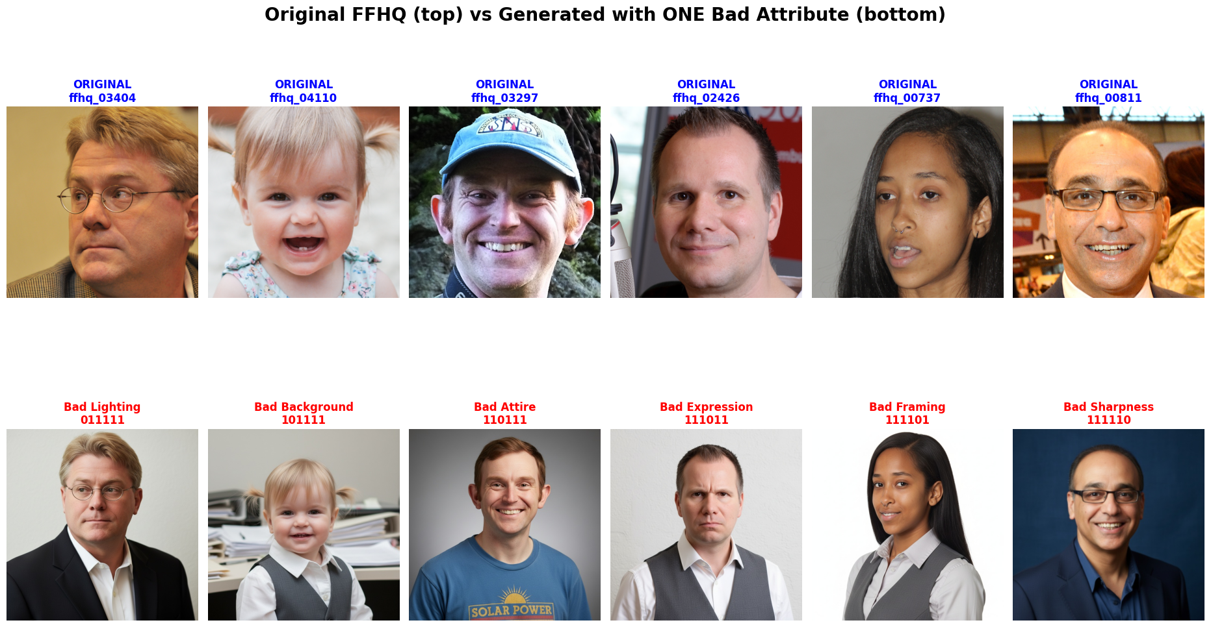

Slide 3
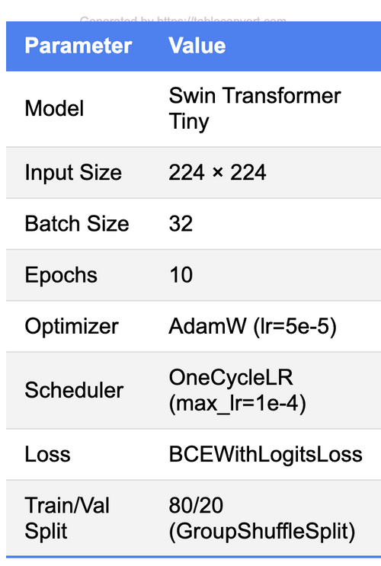
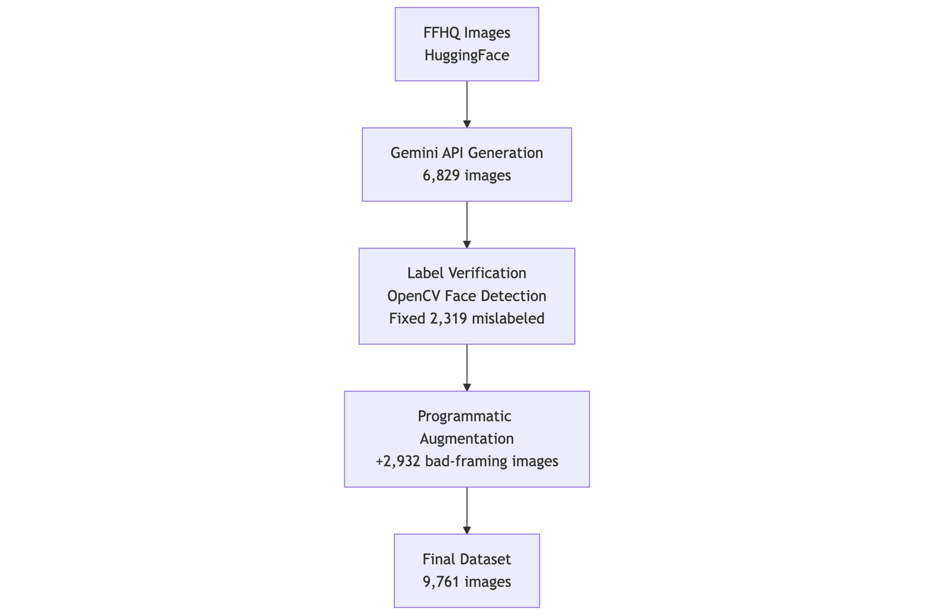
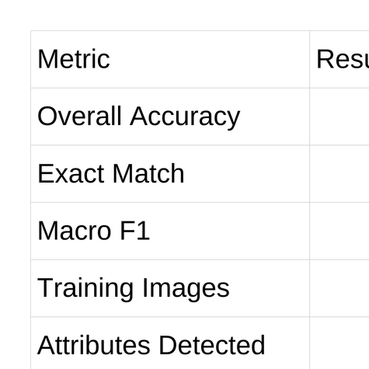
From ~15% to ~70%
perfect match score
Successfully generated a large-scale synthetic dataset of 9,761 professional portraits
Perfect Match From ~15% to ~70% perfect match score by label verification, (Fixed 2,319 mislabeled images (82.8% of "bad framing" were actually good), Framing Balancing, Threshold Tuning

Slide 4
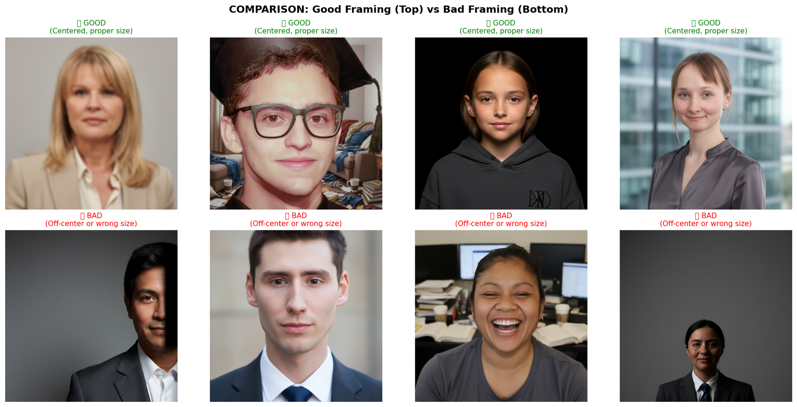
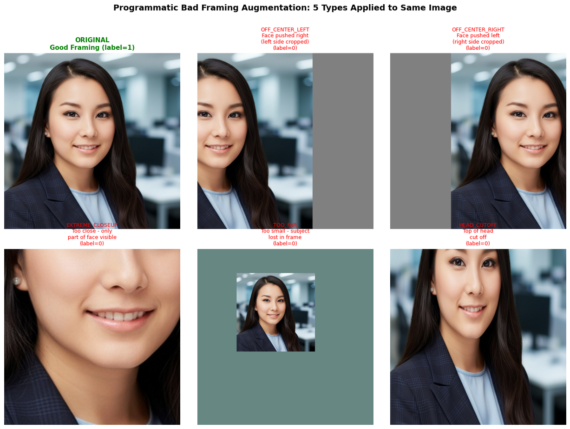
Framing GenAI examples

Slide 5
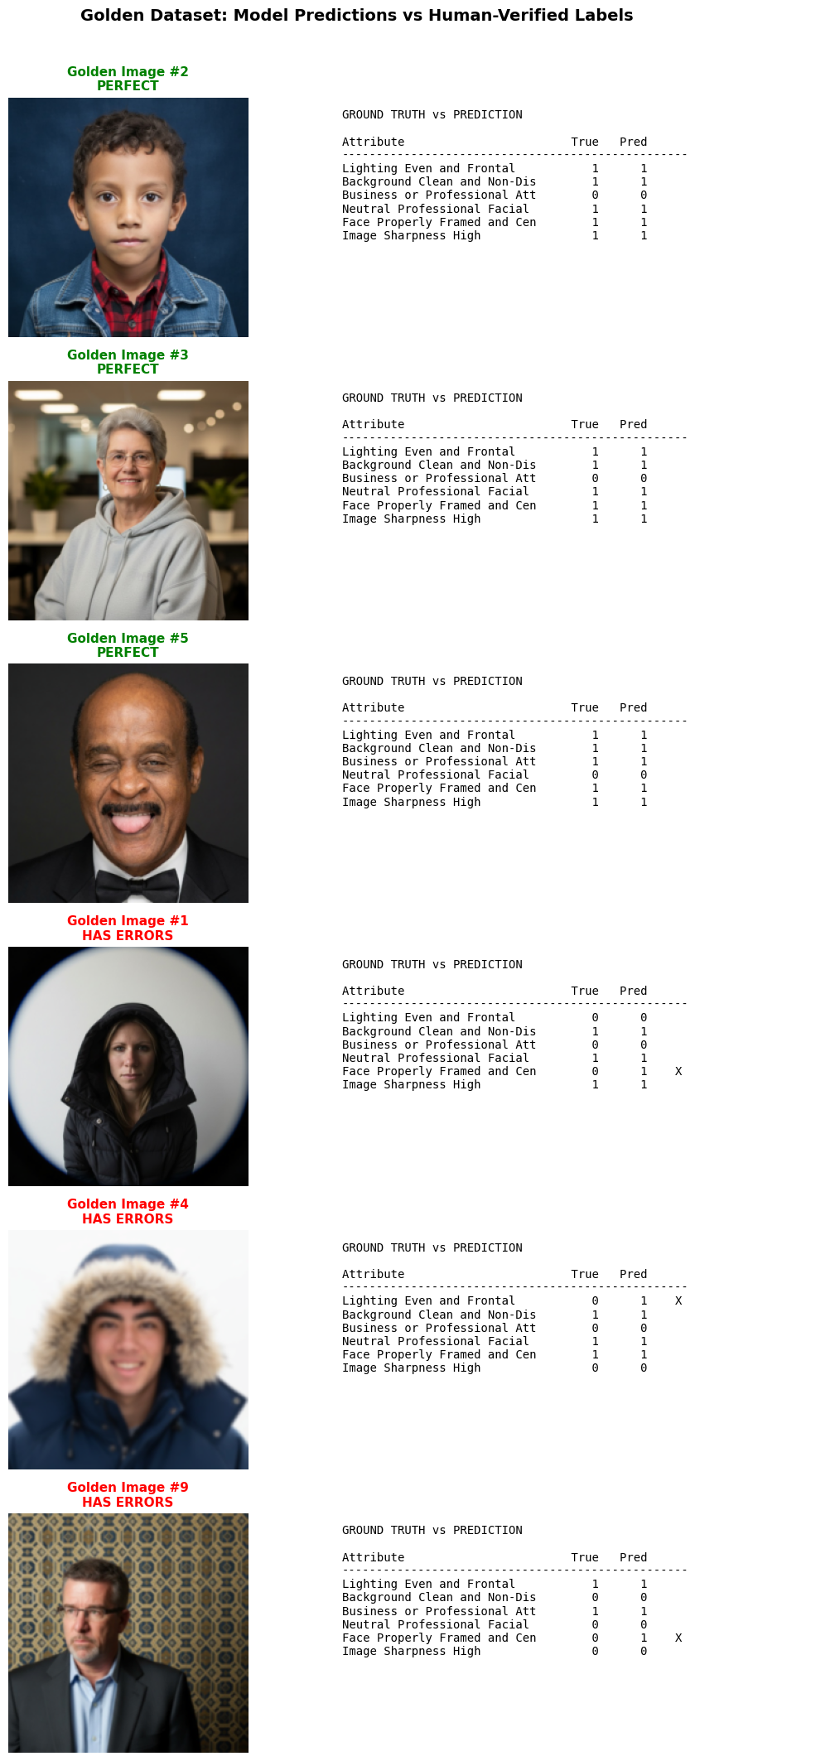
OVERALL ACCURACY (Hamming) 97.0%
EXACT MATCH (all 6 correct) 83.3%
MACRO F1 SCORE 0.982

Slide 6
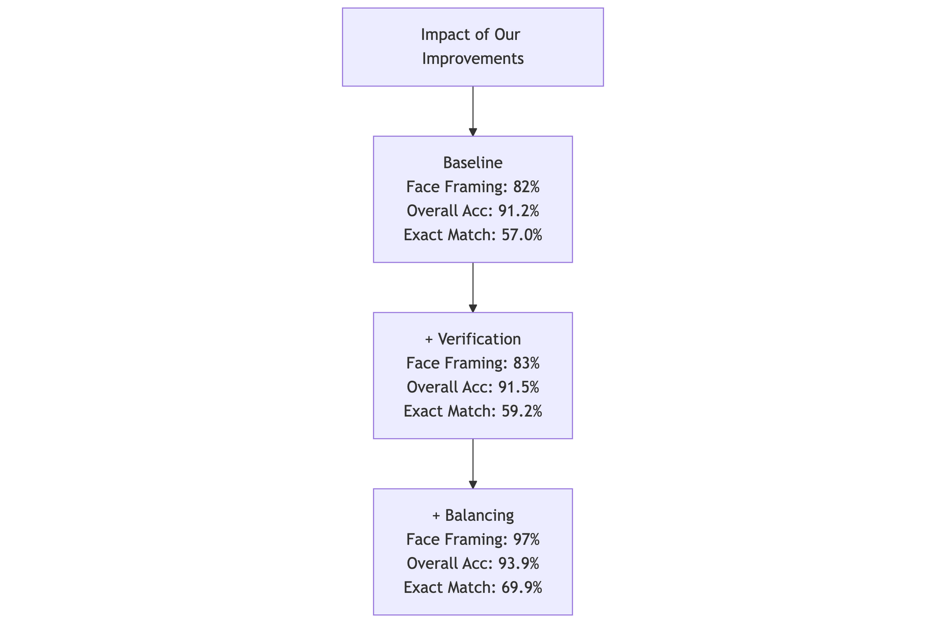
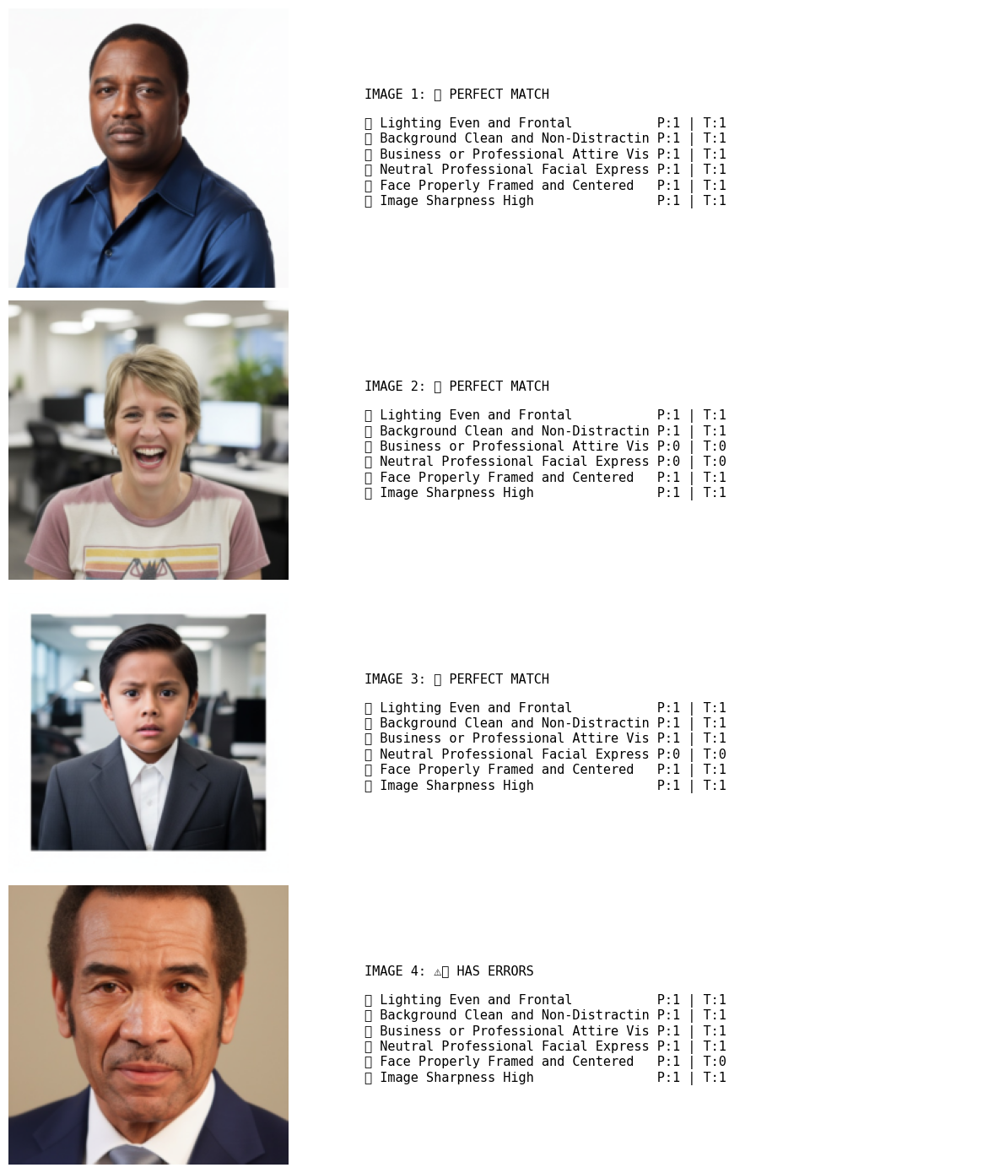

Slide 7
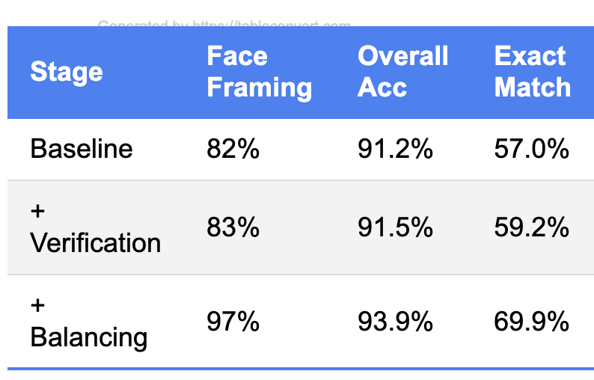
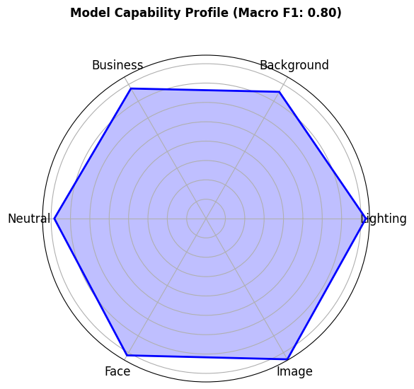
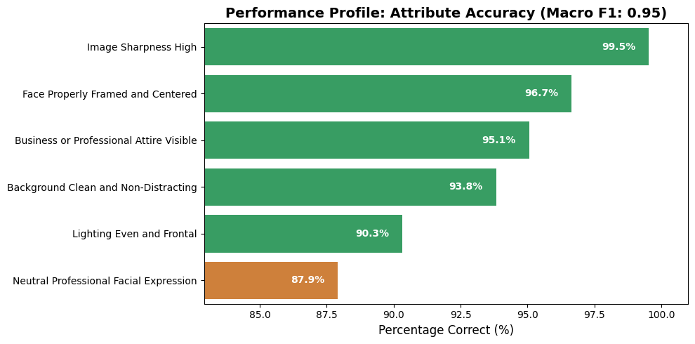
Overall Accuracy 93.89%
Perfect Image Ratio:69.86%
.

Slide 8
